Slide 1


Title: Analysis of Capability of SpaceX Launches and Cost effectiveness
Devendra Kamatam
21-October-2023

Slide 2

Outline
Executive Summary
Introduction
Methodology
Results
Conclusion
Appendix

Slide 3
Executive Summary
Summary of methodologies
Step-1: Data collection : Using API & Web Scraping
Step-2: Exploratory Data Analysis: Using SQL & Pandas and Matplotlib
Step-3: Interactive Visual Analytics: Using Folium & Plotly and Dash
Step-4: Predicting the Best of various Machine Learning Algorithms: Logistic Regression, SVM, Decision Tree and KNN
Summary of all results
Exploratory Data analysis : Charts and Plots
Interactive Visual Analytics : Screenshots
Result comparison : Accuracy of all ML algorithms

Slide 4
Introduction
Project background and context
Space travel is affordable to everyone is the concept followed by companies like Virgin Gallatic, Rocket Lab, Blue Origin and SpaceX.
In this project we will discuss about SpaceX which is capable of providing services in sending spacecrafts into international space station, Startlink, and sending manned machines into space.
As said Space X advertises Falcon 9 rocket launches on its website are much cheaper and affordable with a cost of 62 million dollars compared to other providers cost upward of 165 million dollars each.
The reason for this much of the savings is because Space X can reuse the first stage.
Therefore, the logic is if we can determine if the first stage will land, we can determine the cost of a launch.
Thus, this information can be used if an alternate company wants to bid against space X for a rocket launch.
Therefore, goal of the project is to create a machine learning pipeline to predict if the first stage will land successfully.
Problems you want to find answers
What factors determine if the rocket will land successfully?
The interaction amongst various features that determine the success rate of a successful landing.
What operating conditions needs to be in place to ensure a successful landing program.

Slide 5

Section 1

Slide 6
Methodology
Executive Summary
Data collection methodology:
Data collection performed in 2 methods using API and Webscraping
Perform data wrangling
One-Hot Encoding using the function dummies are used in data wrangling
Perform exploratory data analysis (EDA) using visualization and SQL
Perform interactive visual analytics using Folium and Plotly Dash
Perform predictive analysis using classification models
Logistic regression, Support Vector Machine, Decision Tree, KNN are used in as algorithms for prediction.

Slide 7
Data Collection
The data was collected using various methods
Data collection was done using get request to the SpaceX API.
Next, we decoded the response content as a Json using .json() function call and turn it into a pandas dataframe using .json_normalize().
We then cleaned the data, checked for missing values and fill in missing values where necessary.
In addition, we performed web scraping from Wikipedia for Falcon 9 launch records with BeautifulSoup.
The objective was to extract the launch records as HTML table, parse the table and convert it to a pandas dataframe for future analysis.

Slide 8
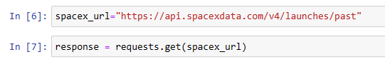
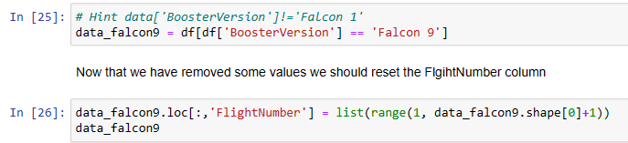
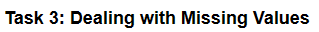
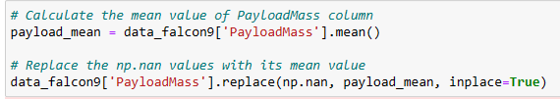
Data Collection – SpaceX API
We used the get request to the SpaceX API to collect data, clean the requested data and did some basic data wrangling and formatting.
The link to the notebook is https://github.com/Devendra-22/SpaceX_Capstone_Project/blob/main/Lab1_Ans_jupyter-labs-spacex-data-collection-api.ipynb

Slide 9
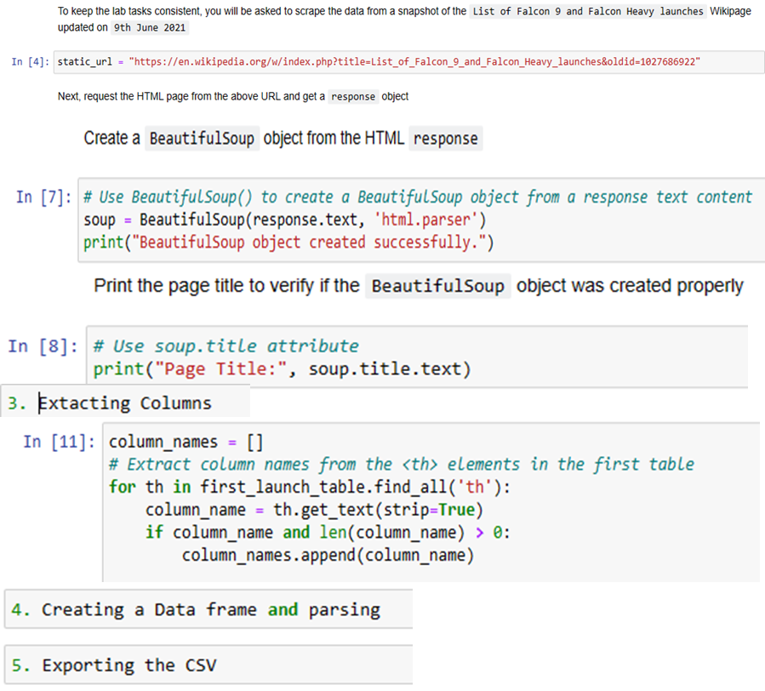
Data Collection - Scraping
Used web scrapping to webscrap Falcon 9 launch records and applied BeautifulSoup
Parsing the table and converted it into a pandas dataframe.
The link to the notebook is https://github.com/Devendra-22/SpaceX_Capstone_Project/blob/main/Lab_2_Ans_jupyter-labs-webscraping.ipynb.
Place your flowchart of web scraping here

Slide 10
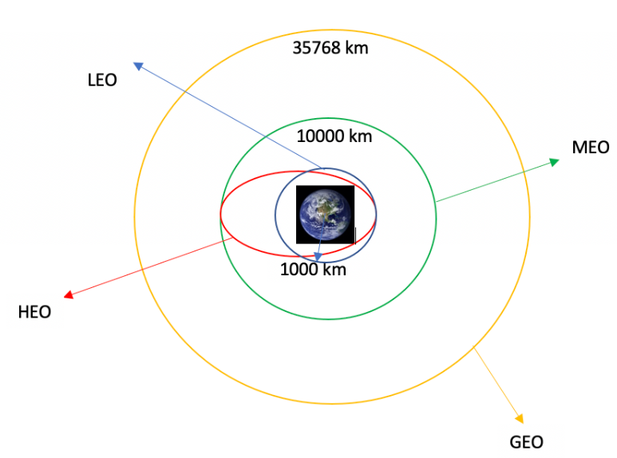
Data Wrangling
Perfomed exploratory data analysis and determined the training labels.
Calculated the number of launches at each site, and the number and occurrence of each orbits
Calculated the number and occurrence of each orbit and mission outcomes
Created landing outcome label from outcome column and exported the results to csv.
The link to the notebook is https://github.com/Devendra-22/SpaceX_Capstone_Project/blob/main/Lab_3_Ans_labs-jupyter-spacex-Data%20wrangling%20(1).ipynb

Slide 11
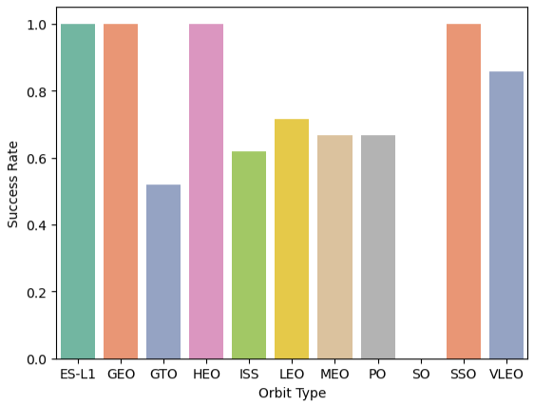
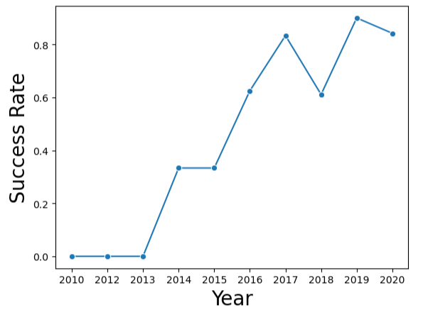
EDA with Data Visualization
The data is explored and visualized the various relationships to identify the trend between
flight number and launch Site, payload and launch site,
success rate of each orbit type,
flight number and orbit type,
launch success rate yearly trend.
The link to the notebook is https://github.com/Devendra-22/SpaceX_Capstone_Project/blob/main/Lab_5_Ans_jupyter-labs-eda-dataviz.ipynb.jupyterlite.ipynb

Slide 12
EDA with SQL
Successfully loaded the SpaceX dataset.
And applied EDA techniques using SQL to identify the insights of the data.
Found the names of Unique Launch sites in the space mission.
Calculated the Total payload mass carried by boosters launched by NASA (CRS)
Found out the average payload mass carried by booster version F9 v1.1
Calculated the total number of successful and failure mission outcomes
And also found out the failed landing outcomes in drone ship, their booster version and launch site names.
The link to the notebook is https://github.com/Devendra-22/SpaceX_Capstone_Project/blob/main/Lab_4_Ans_jupyter-labs-eda-sql-coursera_sqllite.ipynb

Slide 13
Build an Interactive Map with Folium
Marked all launch sites as specified, and added map objects such as markers, circles, lines to mark the success or failure of launches for each site on the folium map.
Assigned the feature launch outcomes (failure or success) to class 0 and 1.i.e., 0 for failure, and 1 for success to easily identify whether it is success or failure.
Using the color-labeled marker clusters, we identified which launch sites have relatively high success rate.
Calculated the distances between a launch site to its proximities and labelled the polyline with distance and also examined the following:
Are launch sites near railways, highways and coastlines.
Do launch sites keep certain distance away from cities.
The link to the notebook is https://github.com/Devendra-22/SpaceX_Capstone_Project/blob/main/Lab_6_Ans_lab_jupyter_launch_site_location.jupyterlite.ipynb

Slide 14
Build a Dashboard with Plotly Dash
An interactive dashboard with Plotly dash is built and executed.
Plotted pie charts showing the total launches by a certain sites
Plotted scatter graph showing the relationship with Outcome and Payload Mass (Kg) for the different booster version.
The link to the notebook is https://github.com/Devendra-22/SpaceX_Capstone_Project/blob/main/SpaceX_Plotly_DashBoard.ipynb

Slide 15
Predictive Analysis (Classification)
Loaded the data and transformed the data and then the data is split into training and testing.
Various machine learning algorithms are defined and tuned with different hyperparameters using GridSearchCV.
The accuracy is chosen as metric inorder to evaluate the performance of each model and compared to identify the best among the Logistic regression, SVM, Decision Tree and KNN. T
The link to the notebook is https://github.com/Devendra-22/SpaceX_Capstone_Project/blob/main/Lab_7_Ans_SpaceX_Machine_Learning_Prediction_Part_5.jupyterlite.ipynb

Slide 16
Results
Exploratory data analysis results
Interactive analytics demo in screenshots
Predictive analysis results

Slide 17

Section 2

Slide 18
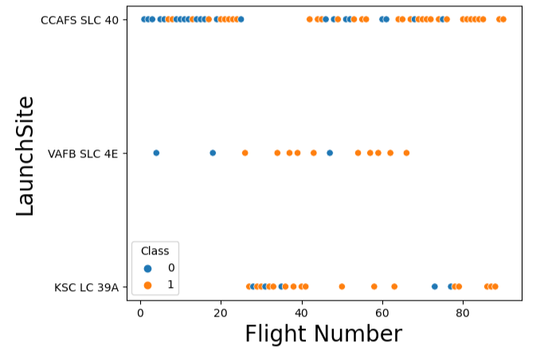
Flight Number vs. Launch Site
Showing a scatter plot of Flight Number vs. Launch Site
From the plot, it is clear that from launch site CCAFS SLC-40 major number of flight are executed when compared with other two sites in which VAFB SLC 4E records with the least number of flights.
It is also revealing the fact that larger the flight amount at a launch site means the greater the success rate at a launch site.

Slide 19
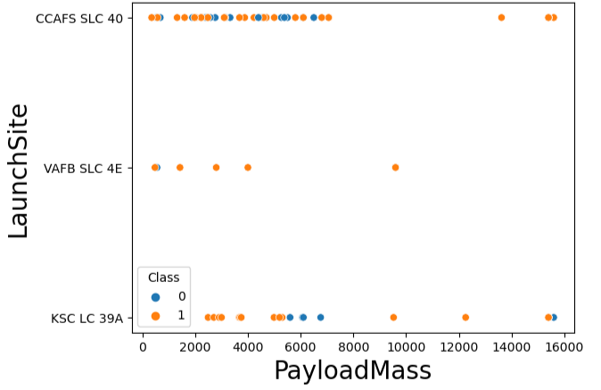
Payload vs. Launch Site
Showing a scatter plot of Payload vs. Launch Site
From the plot, it is clear that from launch site KSC LC 39A and CCAFS SLC 40 has the capacity to launch with the highest payload mass whereas CCAFS SLC 40 has high success rate compared to the prior.
VAFB SLC 4E has the limited payload handling capacity.

Slide 20
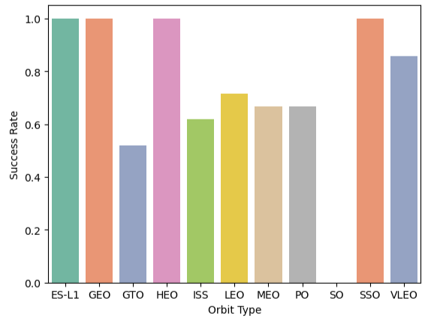
Success Rate vs. Orbit Type
Showing a bar chart for the success rate of each orbit type
From the plot, the highest success rate lies with the Orbit Type – ES-L1, GEO, HEO, SSO with almost 100%.
SO is the orbit type which has 0-success rate which is clearly indicated that not suitable.
LEO orbit type has success rate of nearly 70% followed MEO, PO with 65% and ISS by 60%.

Slide 21
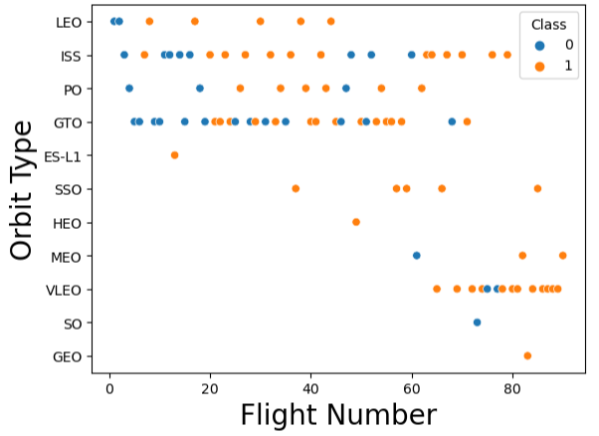
Flight Number vs. Orbit Type
Showing a scatter point of Flight number vs. Orbit type.
From the plot, the highest flight number s are from the Orbit Type – ISS with greater success rate too.
GTO is the orbit type which has mixed success but handling a good number of flight and stands next to ISS.

Slide 22
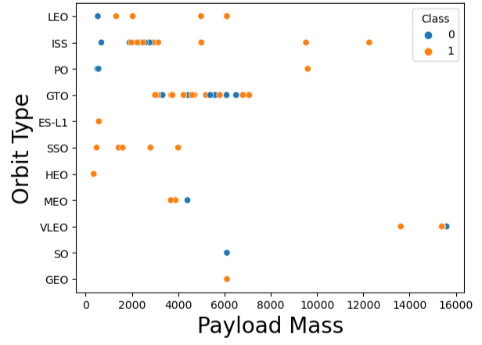
Payload vs. Orbit Type
Showing a scatter point of payload vs. orbit type
From the plot, the highest payload mass carrying capacity lies with ISS with great success rate.
GTO orbit type is restricted for carrying medium payload mass upto 8000 units with reasonable amount of success.
Next orbit type which is suitable is LEO followed by SSO.

Slide 23
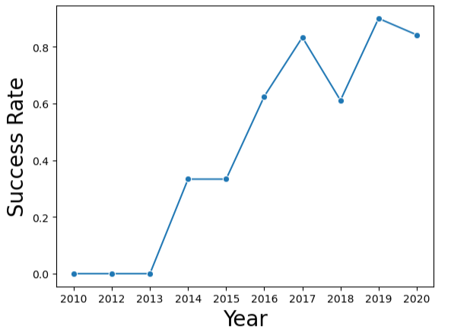
Launch Success Yearly Trend
Showing a line chart of yearly average success rate
From the plot, the highest success rate is achieved in the year 2020 whereas the lowest rate is recorded during 2010 to 2013.
The increasing success rate trend is observed with a constantly from the year 2013 to 2020.
The success little dropped in 2018 but picked and achieved the peak in next year.

Slide 24
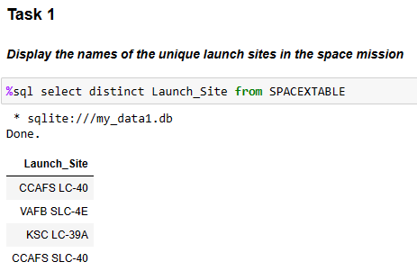
All Launch Site Names
Find the names of the unique launch sites
CCAFS LC-40
VAFB SLC-4E
KSC LC-39A
CCAFS SLC-40
Distinction function is used to get unique data

Slide 25
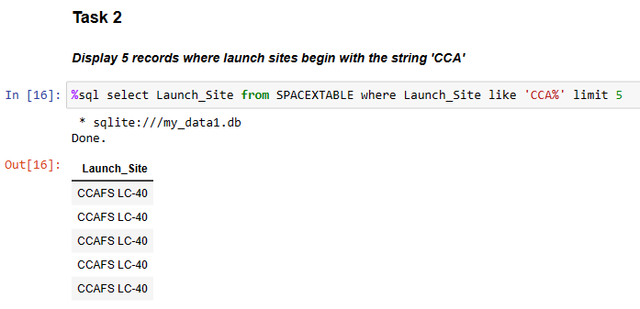
Launch Site Names Begin with 'CCA'
We used the query below to display 5 records where launch sites begin with `CCA` and limited to 5 records.

Slide 26
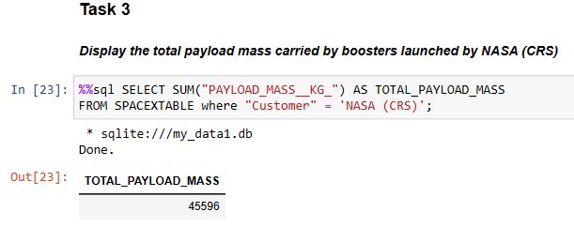
Total Payload Mass
Calculated the total payload carried by boosters from NASA as 45596.
Using SUM the total mass is calculated as shown in below snapshot with code.

Slide 27
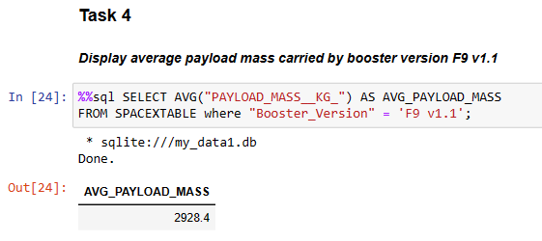
Average Payload Mass by F9 v1.1
Calculated the average payload mass carried by booster version F9 v1.1 as 2928.4.
Using AVG the average mass is calculated as shown in below snapshot with code.

Slide 28
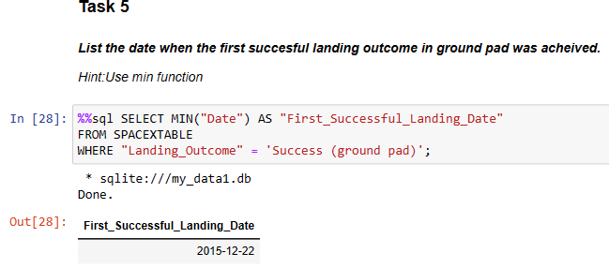
First Successful Ground Landing Date
The date of the first successful landing outcome on ground pad is 2015-12-22.
Using MIN the first landing date is calculated as shown in below snapshot with code

Slide 29
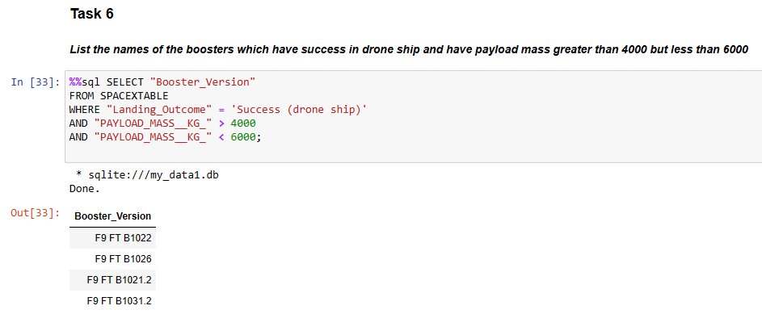
Successful Drone Ship Landing with Payload between 4000 and 6000
The names of boosters which have successfully landed on drone ship and had payload mass greater than 4000 but less than 6000 are shown below and identified using functions “Where”, “and”.

Slide 30
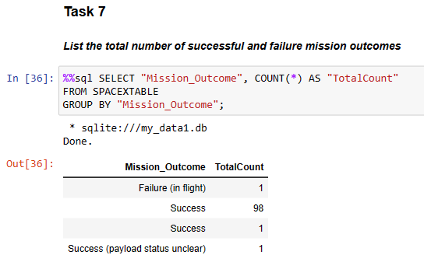
Total Number of Successful and Failure Mission Outcomes
Calculated the total number of successful and failure mission outcomes using COUNT function and Groupby function as shown below snapshot.

Slide 31
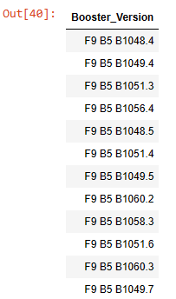
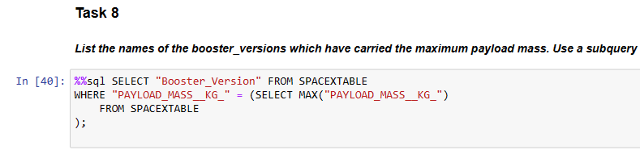
Boosters Carried Maximum Payload
All the names of the booster which have carried the maximum payload mass are shown below using code with a function MAX.

Slide 32
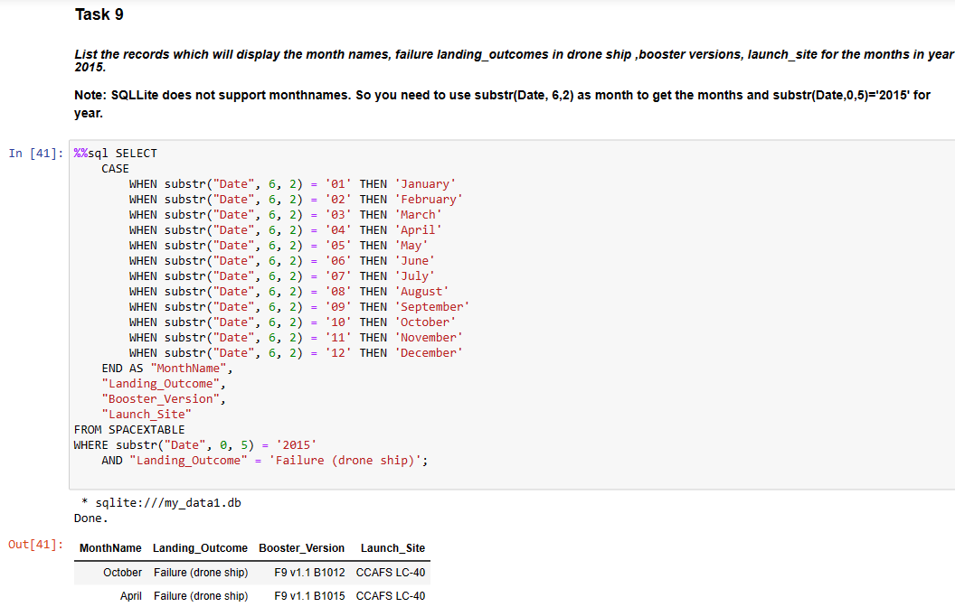
2015 Launch Records
There are two failed landing_outcomes in drone ship, their booster versions, and launch site names for in year 2015 as shown below along with code.

Slide 33
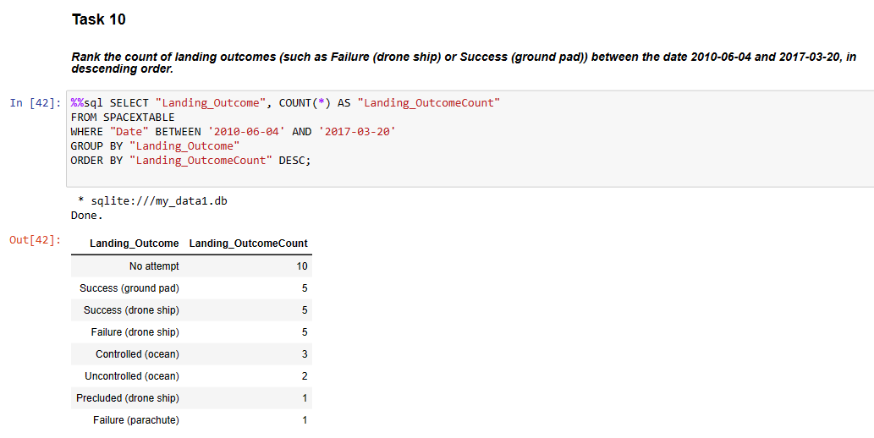
Rank Landing Outcomes Between 2010-06-04 and 2017-03-20
The ranking is for the count of landing outcomes (such as Failure (drone ship) or Success (ground pad)) between the date 2010-06-04 and 2017-03-20, in descending order as shown below and code also shown.

Slide 34

Section 3

Slide 35
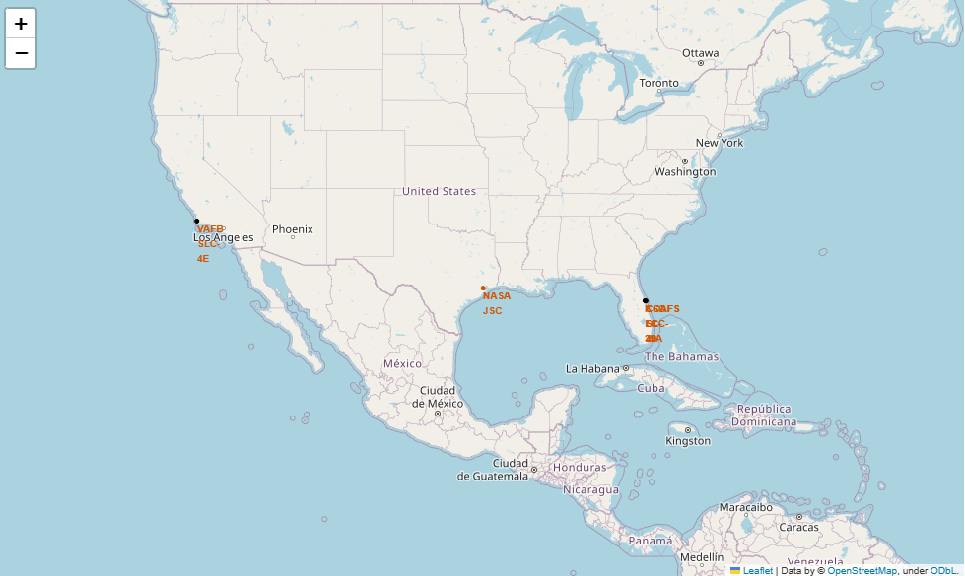
Total launch sites with global map markers
Florida and California is the specific launch sites for SpaceX in USA

Slide 36
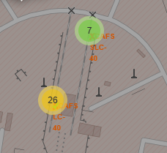
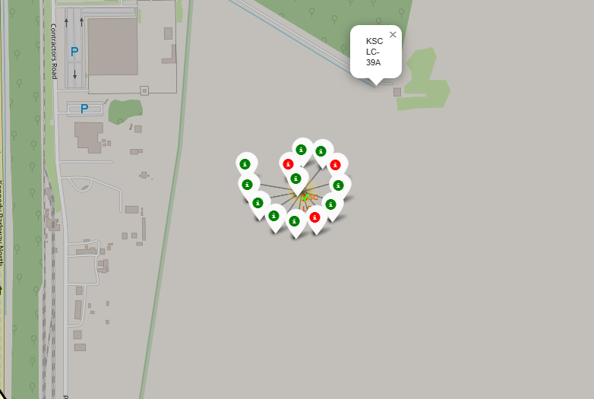
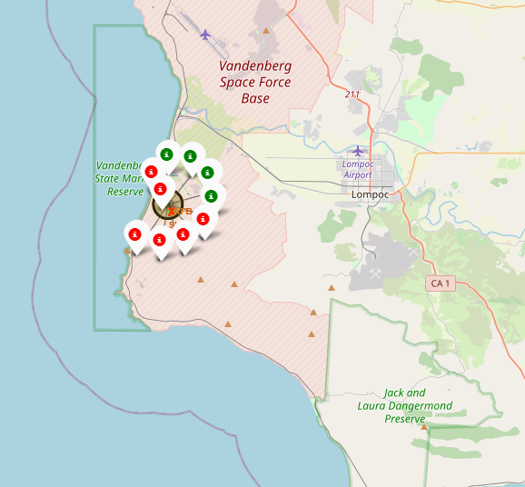
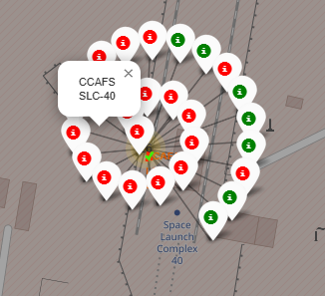
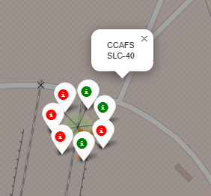
Markers showing launch sites with color labels
Launch Sites in Florida
Launch Sites in California
KSC LC 39A
VAFB SLC 4E
Note:
Green markers represents Success
Red markers represent Failure
CCAFS SLC-40

Slide 37

Distances from Launch Site to Landmarks

Slide 38

Section 4

Slide 39

Pie chart: Success Percentage vs Launch Site

Slide 40

Pie Chart: Launch site having highest launch success

Slide 41

Scatter plot: of Payload vs Launch Outcome
with different payload selected in the range slider

Slide 42

Section 5

Slide 43
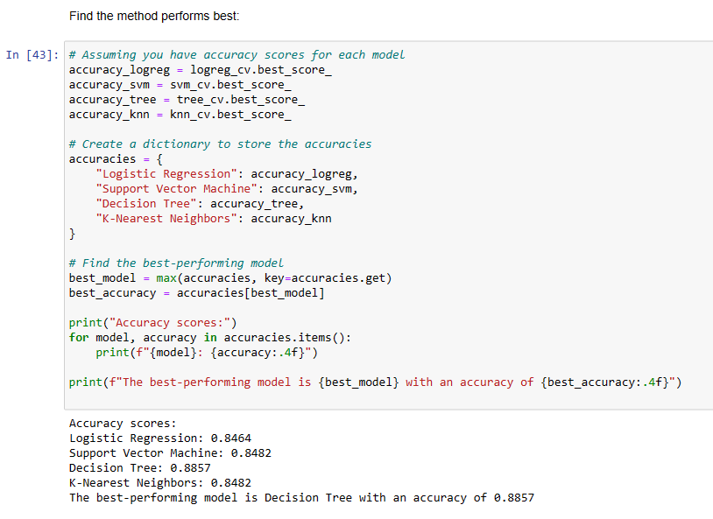
Classification Accuracy
Best Model is: Decision Tree
Accuracy = 88.57%

Slide 44
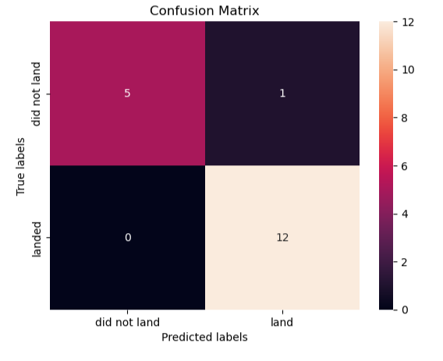
Confusion Matrix
Confusion matrix is represented with distinct colors showing that how the model is predicting.
First Box: The model predicts ‘5’ correctly as “did not land” under “did not land” category.
Second Box: The model predicts ‘1’ wrongly as “did not land” under “land” category.
Third Box: The model predicts ‘0’ correctly as “landed” under “did not land” category.
Fourth Box: The model predicts ‘12’ correctly as “landed” under “land” category.
That means the model is performing at its best and predicting well.

Slide 45
Conclusions
We can conclude that:
The launch sites accommodating larger number of flights are indicating that those launch site has the highest success rate.
The highest success rate is achieved in the year 2020 whereas the lowest rate is recorded during 2010 to 2013.
The increasing success rate trend is observed with a constantly from the year 2013 to 2020.
From the plot, the highest success rate lies with the Orbit Type – ES-L1, GEO, HEO, SSO with almost 100%.
From the plot, it is clear that from launch site KSC LC 39A and CCAFS SLC 40 has the capacity to launch with the highest payload mass whereas CCAFS SLC 40 has high success rate compared to the prior.
The Decision tree classifier is the best machine learning algorithm for this task with an accuracy of 89%

Slide 46


